Slide 1
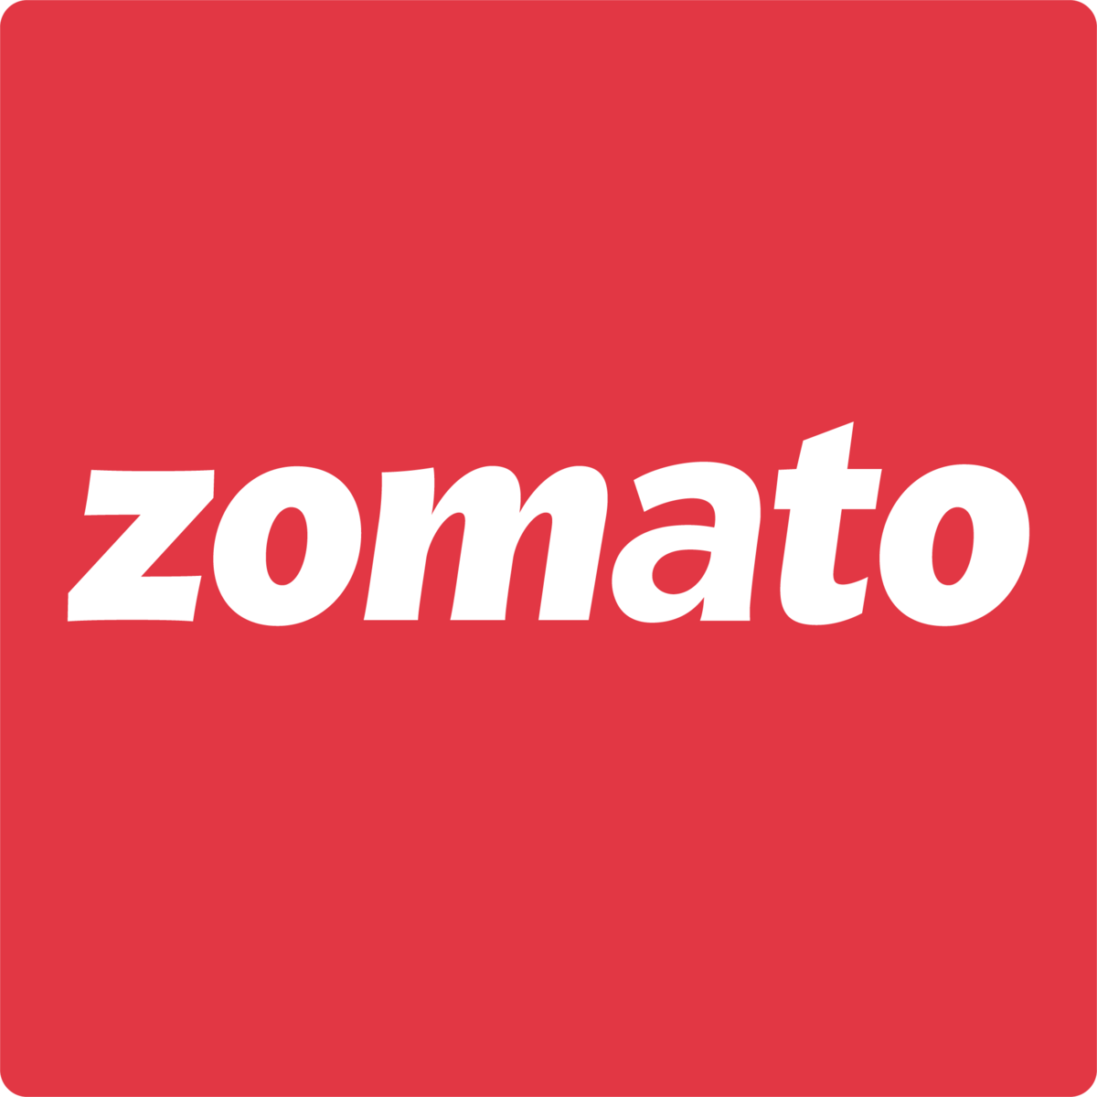
Zomato Restaurants Expansion
Mohit Yadav 25-Sep-2025

Slide 2
About Zomato
🍽️ Founding & Evolution
Founded in 2008 by Deepinder Goyal and Pankaj Chaddah as FoodieBay, a restaurant directory in Delhi.
Rebranded to Zomato in 2010 to avoid confusion with eBay and to better reflect its food-centric identity.
Initially focused on restaurant listings, menus, and reviews before expanding into food delivery in 2015.
🌍 Global Reach
Operates in over 10,000 cities across 24 countries, including the UAE, UK, Philippines, and Qatar.
Offers services like restaurant discovery, table reservations, and food delivery in more than 800 Indian cities.
📈 Business Milestones
Went public in July 2021, raising ₹9,372 crore through its IPO—oversubscribed nearly 38 times.
Became profitable at the EBITDA level in its food delivery segment post-2020, despite pandemic challenges.
Acquired Urbanspoon in 2015 to enter the U.S. and Australian markets.

Slide 3
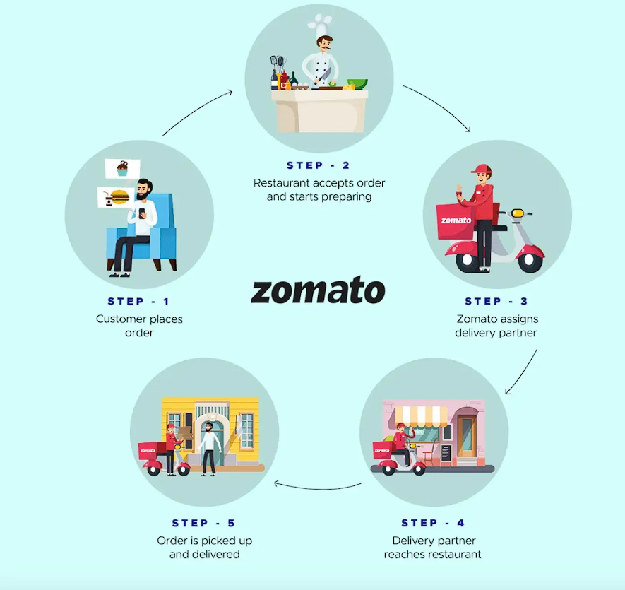
How Zomato Works

Slide 4
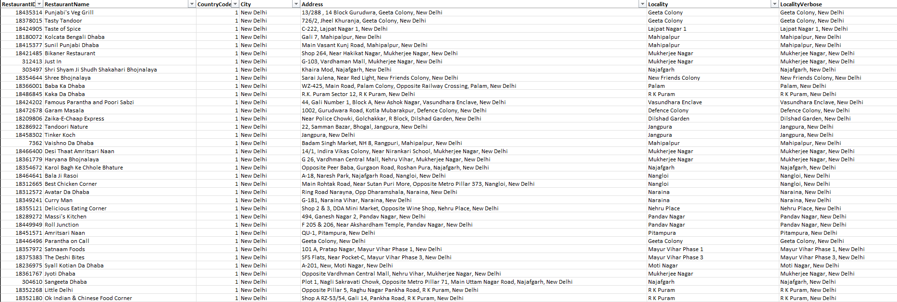
Problem Statement
You are hired as a consultant data analyst by zomato where the team is looking for expansion and opening restaurants. Your task is to come up with strategies/suggestions about opening newer restaurants.

Slide 5
Data Overview
The dataset serves as a critical foundation for strategic analysis, offering comprehensive insights into restaurant operations, geographic distribution, service offerings, pricing structures, and customer engagement metrics. Leveraging this data enables the identification of emerging market trends, supports data-driven decision-making, and informs the optimization of expansion strategies across target regions.
Key Data Elements –
Restaurant Details: ID, name, and address
Location Info: City, country, and map coordinates
Cuisine & Services: Types of cuisine, delivery availability, and table booking options
Pricing & Ratings: Price range, average cost for two, customer ratings, and vote counts
Opening Dates: Useful for spotting market entry trends over time

Slide 6
The dataset comprises a total of 9,527 restaurant entries, with India representing the dominant share—8,643 listings, accounting for over 90% of the total data while Canada has only 4 restaurant.
Established markets—including the United States (419 restaurants) and India (8,643 restaurants)—demonstrate consistent growth and operational maturity within the restaurant sector..

Slide 7
Average Rating
The Philippines (4.47), Indonesia (4.30), and Turkey (4.30) lead in average restaurant ratings, reflecting strong customer satisfaction and positive brand perception. In contrast, India registers the lowest average rating (2.77), suggesting potential gaps in service quality or alignment with customer expectations.
Most countries fall within the 3.5 to 4.3 rating range, indicating generally favorable customer experiences across markets.

Slide 8
Year Wise Restaurants Opening
From 2010 to 2018, the restaurant industry saw steady growth with 1,000+ new openings annually, reflecting strong investor confidence and robust market demand.
Recognizing this growth trend enables strategic market entry, demand forecasting, and competitive benchmarking across high-potential geographies.

Slide 9
Table Booking Distribution
88% lack reservations—adding one boosts experience and differentiation.
Streamlined bookings increase footfall, optimize seating, and grow revenue.

Slide 10
Online Delivery Distribution
With 76% of restaurants lacking online delivery, the sector holds vast untapped potential for revenue expansion.
Embracing delivery can unlock new customer access and serve as a strategic differentiator for accelerated growth.

Slide 11
Suggested Countries to Open Restaurants
United Arab Emirates Restaurant Count: 60 UAE’s sparse listings hint at premium focus, enabling expansion, digital onboarding, and service diversification opportunities
Singapore Restaurant Count: 20 Singapore’s satisfaction signals efficiency, digital maturity, and a scalable model for compact urban market optimization.
United Kingdom
Restaurant Count: 80
UK’s balanced delivery and reservations boost satisfaction, enabling premium positioning and experience growth.

Slide 12
India, Turkey thrive on affordability; Singapore, UK poised for luxury dining growth.
Canada, USA, UAE enable tiered pricing and premium service model deployment.

Slide 13
Average Cost for Two In the Suggested Countries
Singapore (₹10,122): Launch a Michelin-style modern Indian restaurant with immersive tech and curated tasting menus for ultra-premium diners.
UAE (₹3,957): Open a royal Indian–Middle Eastern fusion concept with lavish décor, luxury brunches, and theatrical presentation.
UK (₹5,312): Introduce a chic Indian bistro offering artisanal comfort food, seasonal chef-led experiences, and elevated casual dining.

Slide 14
North Indian cuisine dominates popularity across countries, often paired with Chinese or Mughlai flavors to enhance appeal.
Street food, fast food, and bakery items also show strong traction, reflecting diverse consumer preferences.

Slide 15
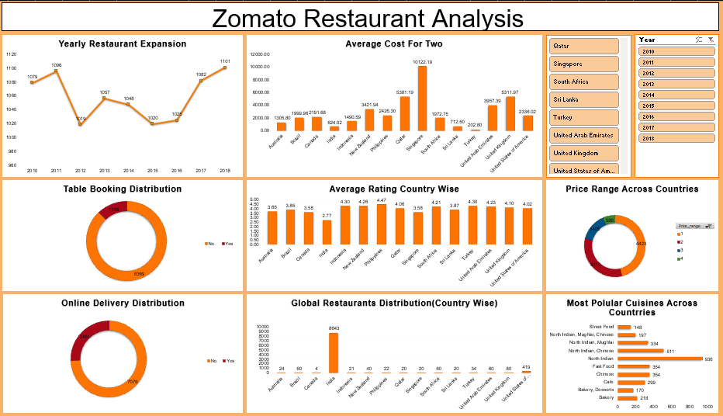
Dashboard

Slide 16
Conclusion
Our analysis of Zomato’s restaurant data reveals compelling opportunities for global expansion. By identifying regions with high consumer demand—such as the UAE, Singapore, and the UK—and aligning offerings with local demographic and cultural preferences, Zomato can strategically position itself for market entry.
Leveraging its strengths in digital engagement, data-driven personalization, and operational scalability, the company is well-equipped to deliver differentiated dining experiences that resonate across diverse markets. This approach not only enhances brand visibility and customer loyalty but also drives sustainable growth through targeted investments and efficient resource allocation.
By integrating competitive benchmarking, pricing intelligence, and customer behavior insights, Zomato can refine its go-to-market strategy and establish itself as a leader in the global food-tech ecosystem.

Slide 17
Thank you

